Slide 1
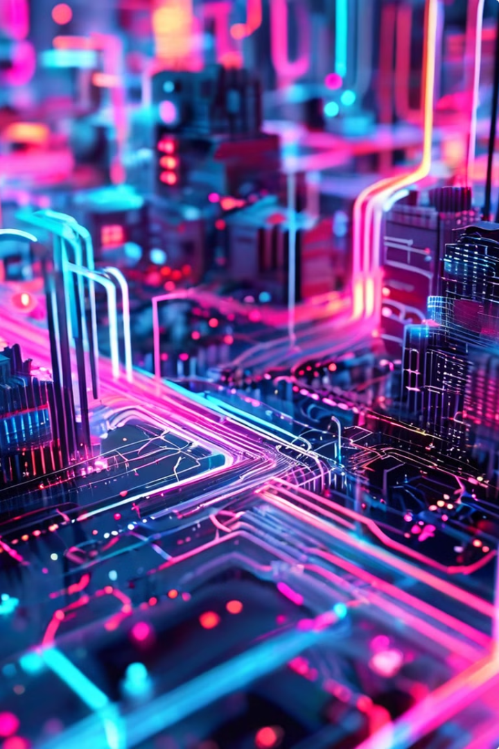

Introduction to AI, Machine Learning, and Deep Learning
Artificial intelligence (AI), machine learning (ML), and deep learning (DL) are rapidly transforming various industries. Understanding these technologies is crucial for navigating the future.

Slide 2
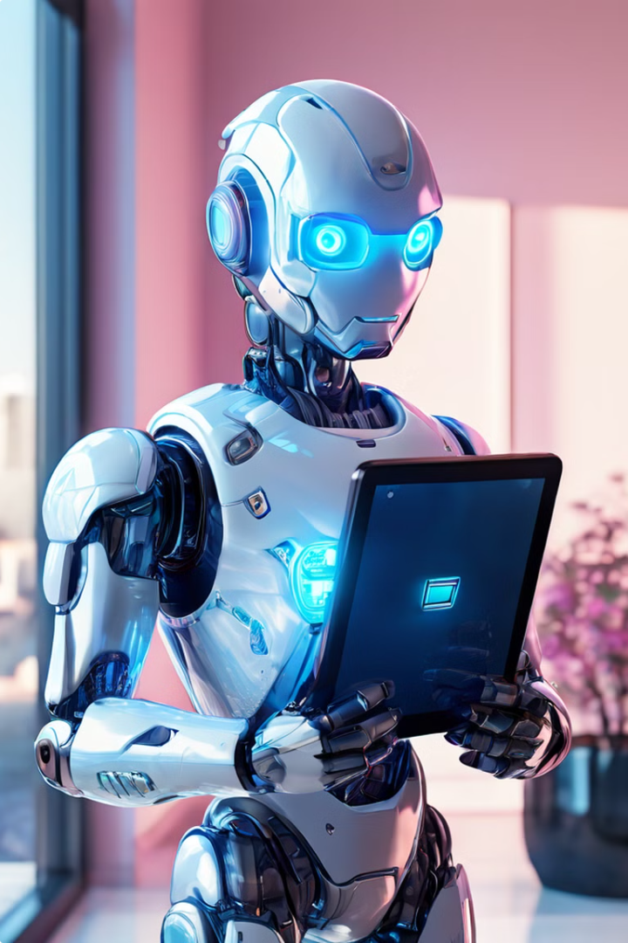
What is Artificial Intelligence (AI)?
AI encompasses a wide range of techniques that enable machines to mimic human intelligence. It aims to create systems that can perform tasks that typically require human cognition, such as learning, problem-solving, and decision-making.
Thinking Machines
AI systems can process information, analyze patterns, and make predictions.
Learning and Adapting
AI algorithms can learn from data and improve their performance over time.
Intelligent Automation
AI is used to automate tasks, streamline processes, and enhance efficiency.

Slide 3

Understanding Machine Learning
Machine learning is a subfield of AI that focuses on training computers to learn from data without explicit programming. It uses statistical techniques to identify patterns and make predictions based on the data it's trained on.
1
Supervised Learning
The algorithm is trained on labeled data, allowing it to learn from known examples.
2
Unsupervised Learning
The algorithm explores unlabeled data to discover patterns and relationships.
3
Reinforcement Learning
The algorithm learns through trial and error, receiving rewards for desired actions.

Slide 4
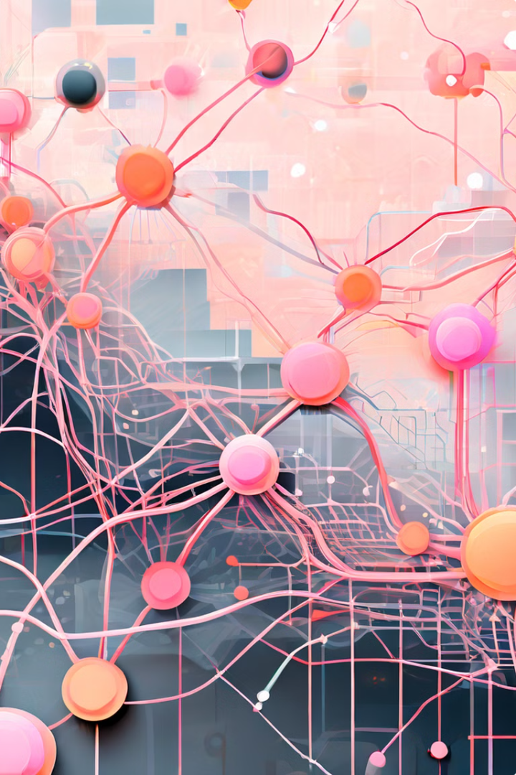
Exploring Deep Learning
Deep learning is a subset of machine learning that utilizes artificial neural networks with multiple layers to extract complex features from data. It excels at tasks like image recognition, natural language processing, and speech synthesis.
1
Input Layer
Receives raw data, such as pixels in an image or words in a sentence.
2
Hidden Layers
Process and transform the input data through multiple layers of interconnected nodes.
3
Output Layer
Generates the final prediction or classification, based on the processing in the hidden layers.

Slide 5
Generative AI: Capabilities and Applications
Generative AI refers to AI systems capable of creating new content, such as images, text, music, and even code. It utilizes deep learning algorithms to learn patterns from existing data and generate novel outputs based on that knowledge.
Image Generation
Text Generation
Music Composition
Creating realistic images, art, and visual effects.
Writing articles, stories, poetry, and even scripts.
Composing original music pieces in various genres and styles.

Slide 6





Applied AI: Real-World Use Cases
Applied AI focuses on utilizing AI technologies to solve real-world problems and address specific challenges across various industries. It involves integrating AI systems into existing workflows and processes to enhance efficiency, accuracy, and decision-making.
Healthcare
Diagnosis, treatment planning, drug discovery.
Manufacturing
Predictive maintenance, quality control, robotics.
Finance
Fraud detection, risk assessment, personalized financial advice.
Transportation
Autonomous vehicles, traffic optimization, route planning.

Slide 7

Differences and Connections Between AI, ML, and DL
AI, ML, and DL are closely related but distinct concepts. AI is the overarching field, while ML is a subset focusing on learning from data. Deep learning, in turn, is a subset of ML that utilizes artificial neural networks.
AI
ML
DL
Broader field
Subset of AI
Subset of ML
Focuses on mimicking human intelligence
Focuses on learning from data
Utilizes deep neural networks
Includes various techniques
Uses statistical techniques
Excels in complex tasks

Slide 8
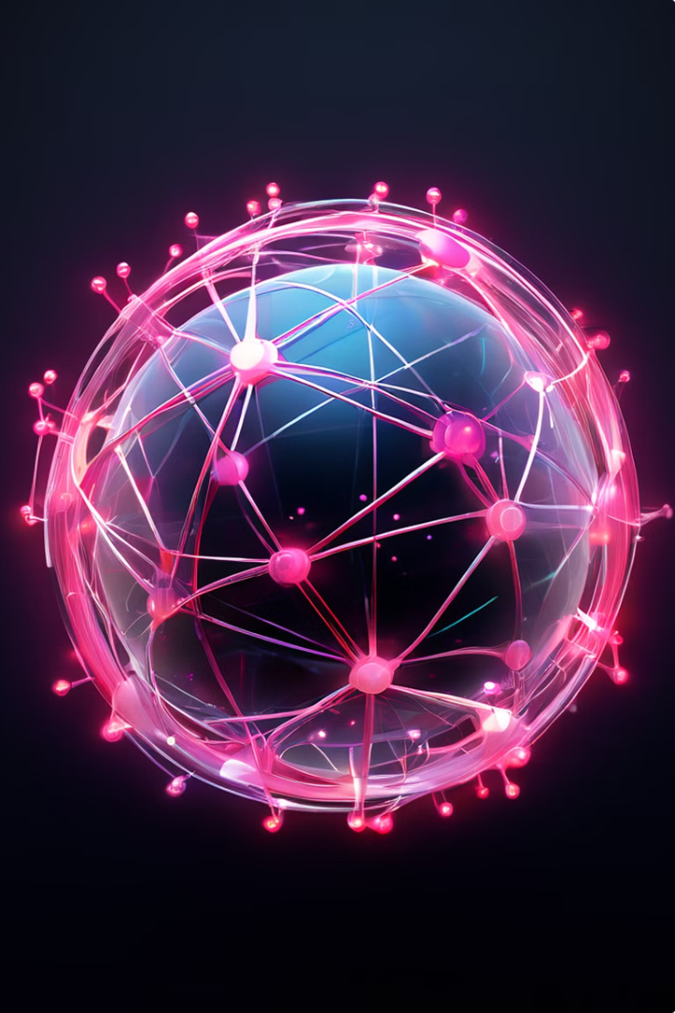



Conclusion and Key Takeaways
AI, ML, and DL are transformative technologies with the potential to revolutionize various aspects of our lives. Understanding these technologies is essential for navigating the future and harnessing their power for positive impact.
AI
The broader field of mimicking human intelligence.
ML
A subset of AI focused on learning from data.
DL
A subset of ML utilizing deep neural networks.

